Slide 1

BEGINNER PROGRAMMING LESSON
Common P-Brick Problems & Solutions

Slide 2
LESSON OBJECTIVES
Learn how to work solve common brick problems

Slide 3
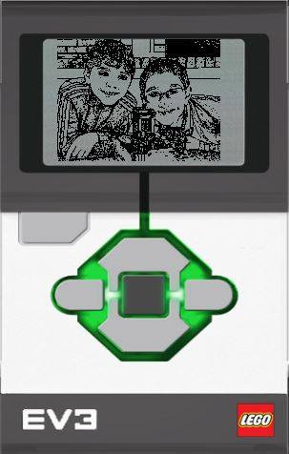
My BRICK IS STUCK AND WILL NOT TURN OFF
If your EV3 Brick suddenly stops working and cannot be shut down through the normal process, you will need to reset your EV3 Brick. Resetting the EV3 Brick does not delete existing files and projects from previous sessions in the EV3 Brick memory. Files and projects from the existing session will be lost.
Make sure that the EV3 Brick is turned on.
Hold down the Back, Center, and Left buttons on the EV3 Brick.
When the screen goes blank, release the Back button.
When the screen says “Starting,” release the Center and Left buttons.
Source: Text from EV3 User Guide

Slide 4
MY BRICK IS STUCK in STARTING MODE
When a brick fails to complete a firmware update successfully, upon rebooting it gets stuck at the "Starting......" screen and never finishes booting.”
1) Remove and reinsert battery
2) Hold down Center and Right button together until you see “Updating”
3) Connect Brick to Computer and update the firmware
Source: Text from “Recovery from Failed Firmware Update”, STEMRobotics (Randy Steele)

Slide 5
My BRICK IS STUCK DURING A FIRMWARE UPDATE
If for some reason your EV3 Brick stops working during the firmware update process, you will need to manually update the firmware by doing the following (the EV3 Brick still needs a USB connection to your computer):
Hold down the Back, Center, and Right buttons on the EV3 Brick.
When the EV3 Brick restarts, release the Back button.
When the screen says “Updating,” release the Center and Right buttons and click the Download button in the Firmware Update tool. The firmware will be downloaded to your EV3 Brick, which will restart itself.
Source: Text from EV3 User Guide, Image from Legoengineering.com

Slide 6
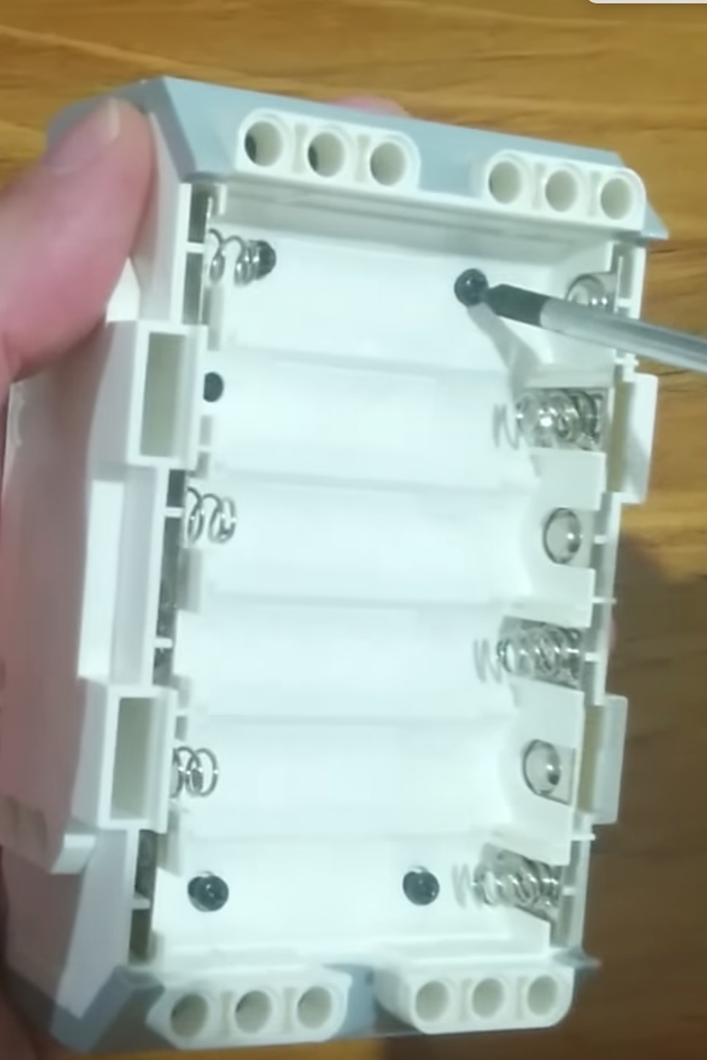
Fully Charged Battery, but the Brick doesn’t Turn ON
Check battery contacts
Sometimes, the battery contacts in the brick have been bent
Remove rechargeable battery or AA batteries and straighten out contacts.
Reinsert battery

Slide 7
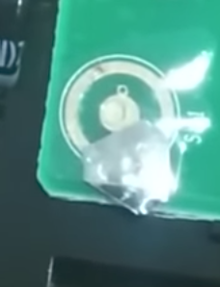
MY BRiCK Button is stuck
There is little piece of curved metal under each brick button. This must have moved out of place.
Remove battery
Unscrew four black screws
Reposition the button so it makes a contact
Screw back the case
Refer to video by Damien Kee
https://youtu.be/NNoutMLxmJ0
Image credits: Damien Kee

Slide 8
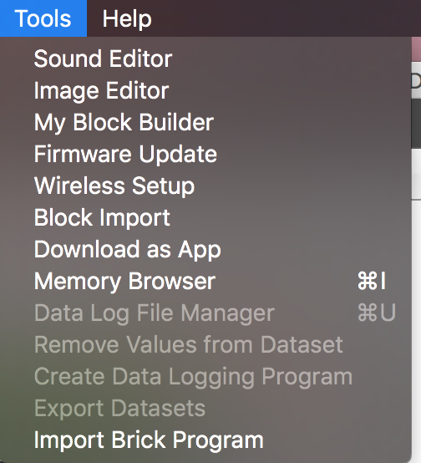
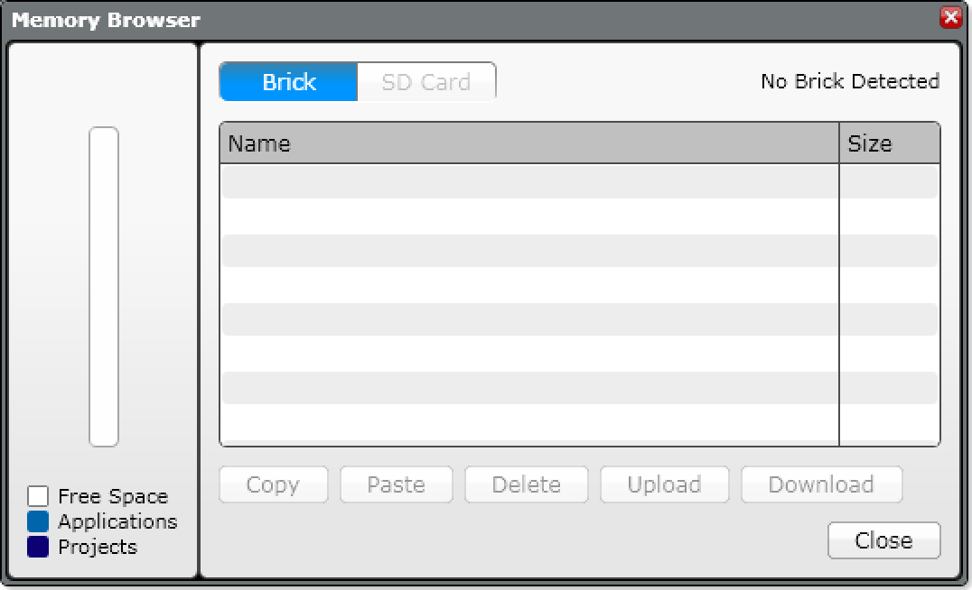
I want to ADD/delete files on the brick
Connect to your brick
In your software, go to FILE → Memory Browser
Upload – copy a file from the brick to the computer
Download – copy a file from your computer to the brick
Delete – delete a file from the brick

Slide 9
I Lost my program, but it’s on the Brick! HELP!
Can I retrieve a program from the brick if I have lost the code on my computer?
Unfortunately, if you lost the program on your computer, there is NO WAY to get the program off the brick and back to your computer.
What about that Upload button in Memory Browser?
It will let you get a copy of a compiled (binary) version of your program. But you will not be able to view or edit the program in your EV3 software again.
Always back up your programs!

Slide 10
CREDITS
This tutorial was created by Sanjay Seshan and Arvind Seshan
More lessons are available at www.ev3lessons.com
This work is licensed under a Creative Commons Attribution-NonCommercial-ShareAlike 4.0 International License.

